Slide 1
C# DataTypes
Naima Jackson
10/08/2021

Slide 2
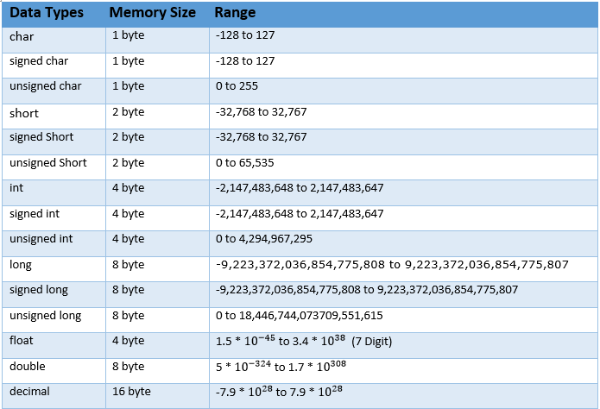
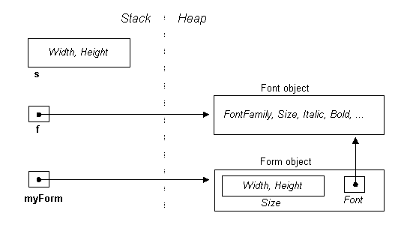
What are C# datatypes & Why We Need Them
C# Datatypes are split into two categories: value and reference types
Predefined C# datatypes are int, long, short, byte, float, double, long, short, Boolean, char, decimal, uint, nint, nuint, ulong, sbyte, ushort, object, string, and DateTime.
C# is strongly typed
Stack vs Heap

Slide 3


LET’S GET HYPE !! (ABOUT DATA TYPES)

Slide 4
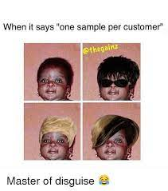
Datatype Alias
Alias | .NET Type | Type
byte | System.Byte | struct
sbyte | System.SByte | struct
int | System.Int32 | struct
uint | System.UInt32 | struct
short | System.Int16 | struct
ushort | System.UInt16 | struct
long | System.Int64 | struct
ulong | System.UInt64 | struct
float | System.Single | struct
double | System.Double | struct
char | System.Char | struct
bool | System.Boolean | struct
object | System.Object | Class
string | System.String | Class
decimal | System.Decimal | struct
DateTime | System.DateTime | struct

Slide 5
Datatypes Have Default Values
Generally speaking these types are either zero or null but there are some special exceptions shown below
DataTypes | Default Values
byte | 0
short | 0
int | 0
long | 0L
float | 0.0f
double | 0.0d
char | '\u0000'
String (or any object) | null
boolean | false

Slide 6
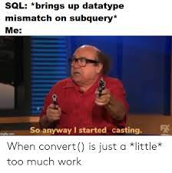
Can Be Converted Implicitly and Explicitly
Implicit Conversion From | To
sbyte | short, int, long, float, double, decimal
byte | short, ushort, int, uint, long, ulong, float, double, decimal
short | int, long, float, double, or decimal
ushort | int, uint, long, ulong, float, double, or decimal
int | long, float, double, or decimal.
uint | long, ulong, float, double, or decimal
long | float, double, or decimal
ulong | float, double, or decimal
char | ushort, int, uint, long, ulong, float, double, or decimal
float | Double
It’s cool but comes with restrictions
Casting(What Happens?)
Cannot implicitly convert to u number of same type
Conversion from signed to unsigned datatypes can cause data loss.

Slide 7
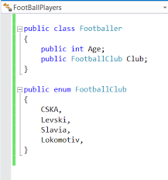
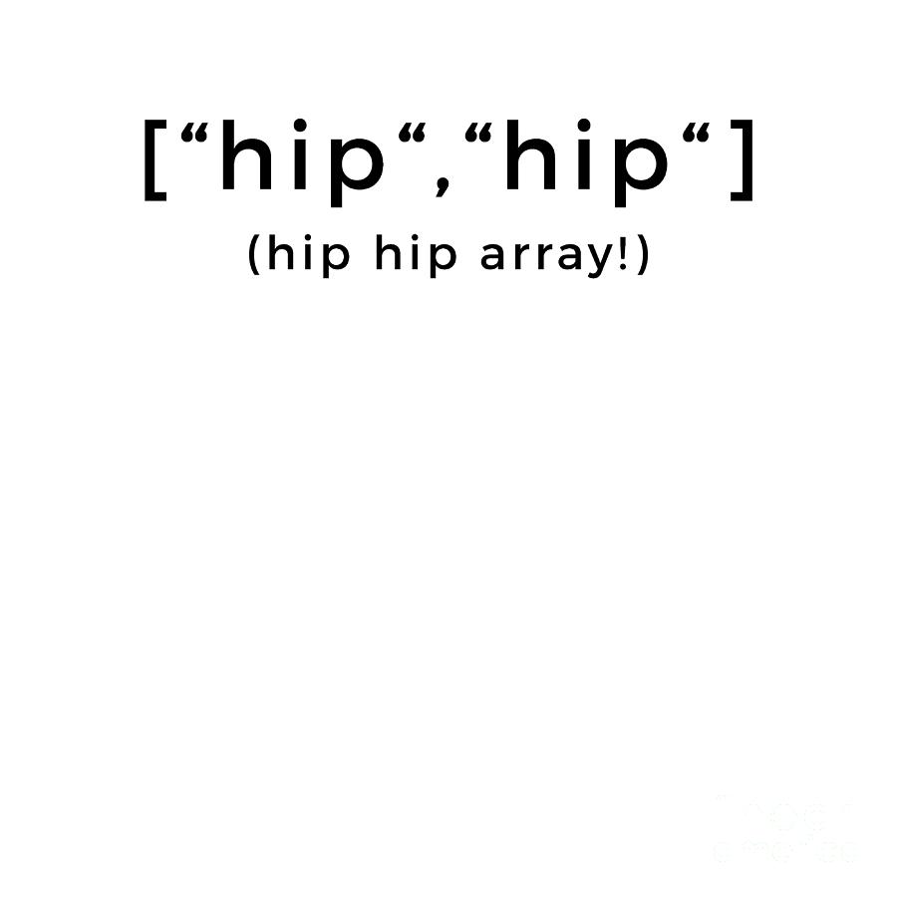
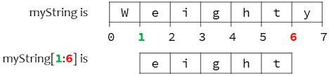
Reference Types And What They Do
Reference Datatypes include string, arrays, delegates, dynamic, obj and class and more.
WHAT IS DYNAMIC ???
Avoid compile time type checking and instead type is resolved at runtime, Can change at run time based on assigned value.
WHAT IS A DELEGATE?!?
A delegate is a type that represents references to methods with a particular parameter list and return type.

Slide 8
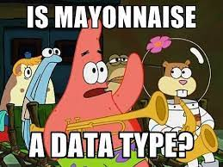
MORE FUN DATatypes
Record
StringBuilder
Inteface
Enum
Struct

